Slide 1



Industrial Training On Machine Learning Code: CSE-458
Name: Estiak Hasan Emon
ID: 201002059 Department : CSE
Green University of Bangladesh
Academic Supervisor
Industrial Supervisor
Name : Ms. Abida Sultana
Designation : Lecturer
Department : CSE
Green University of Bangladesh
Name : Kamrul Hasan
Designation : Software Engineer
Department : Software Development
Unicorn Software and Solutions
‹#›

Slide 2
Table of Contents
Introduction
Motivation
Objectives
Company Profile
Problem-Solving Skills
Tools & Techniques
Project Demonstration
Conclusion
References
‹#›
07-03-2024

Slide 3

Introduction
Unicorn Software and Solution provided me with an invaluable opportunity to bridge the gap between theoretical knowledge and practical application.
The duration of the internship was 5 week, which allowed me to fully involve myself in the company's operations and projects.
‹#›
07-03-2024

Slide 4

Motivation
Learning Opportunities
Professional Growth
Career Exploration
Better decision making
Contribution to Projects
Acquire industry-relevant skills and knowledge
‹#›
07-03-2024

Slide 5

Objectives
To develop programming language skills
To enhance Problem-Solving Skills
To improve Collaboration and Teamwork
To gain Project Management Skills
To promote Innovative Thinking
‹#›
07-03-2024

Slide 6
Company Profile
Unicorn Software and Solutions Ltd. Founded in 2005 and headquartered in Khulna, Bangladesh, in order to help companies with their IT services and solutions.
Services:
Software Development
Web design, Development
Mobile Application (Android & IOS)
Deep Learning
‹#›
07-03-2024

Slide 7

Problem-Solving Skills
Analytical Thinking
Attention to Detail
Creative Thinking
Technical Proficiency
Communication
Research Skills
Time Management
Training & Testing
‹#›
07-03-2024

Slide 8








Tools & Techniques
‹#›
07-03-2024

Slide 9
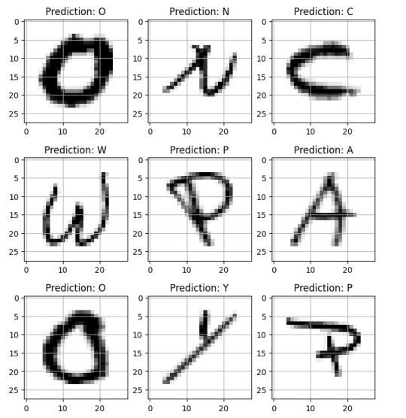
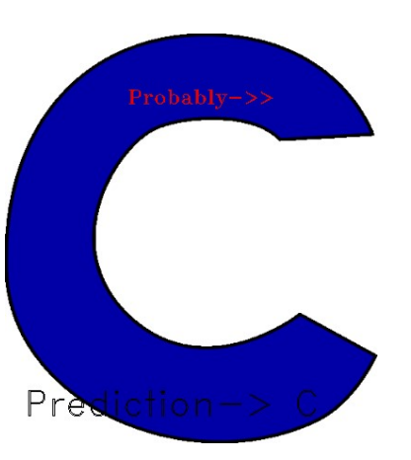
Project Demonstration
07-03-2024
‹#›

Slide 10

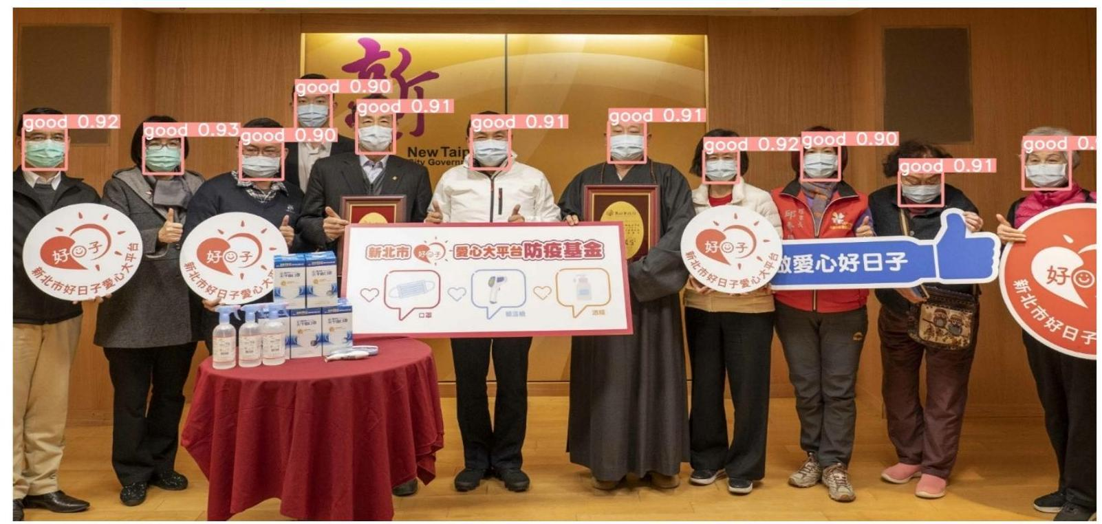
Project Demonstration (Cont.)
‹#›
07-03-2024

Slide 11

Conclusion
Internship at Unicorn Software & Solutions Ltd. provided valuable insight
This internship sets the stage for success in creativity & problem solving skills
‹#›
07-03-2024

Slide 12
References
[1] https://ieeexplore.ieee.org/abstract/document/9315679
[2] https://link.springer.com/article/10.1007/s100320200076
[3] https://ieeexplore.ieee.org/abstract/document/9377205
[4] https://ieeexplore.ieee.org/abstract/document/8680708
‹#›
07-03-2024

Slide 13
Thank You!

